Slide 1

*metrics Project Introduction
*metrics in Transition - Final Workshop
27-28 March 2019
SUB Göttingen
Astrid Orth

Slide 2
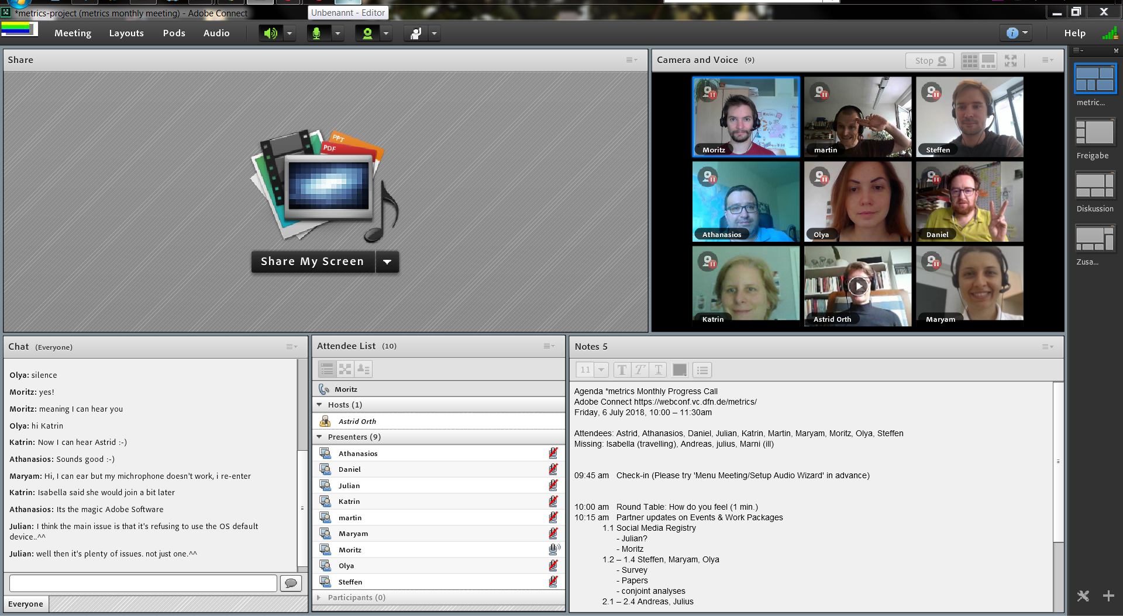
*metrics Project
DFG-funded 01/2017 – 05/2019
Partner
State and University Library Göttingen (SUB),
Leibniz-Informationszentrum Wirtschaft (ZBW)
Headoffice Gemeinsamer Bibliotheksverbund (VZG)
Leibniz Institute for the Social Sciences (GESIS)

Slide 3
*metrics Project Aims
MEasuring The Reliability and perceptions of Indicators for interactions with sCientific productS
Understanding of *metrics, especially in terms of their general significance and their perception amongst stakeholders
How can alternative metrics contribute to a new set of indicators for scientific output?
Notes:
How reliable are *metrics? This includes questions like: - How are researchers using social media? - Are all platforms used similarly? - Can we find patterns in usage of functions?
- Do they distort the image and need caution in construction of metrics?
How are *metrics perceived?
What do researchers think about them, are they understanding and using them?

Slide 4
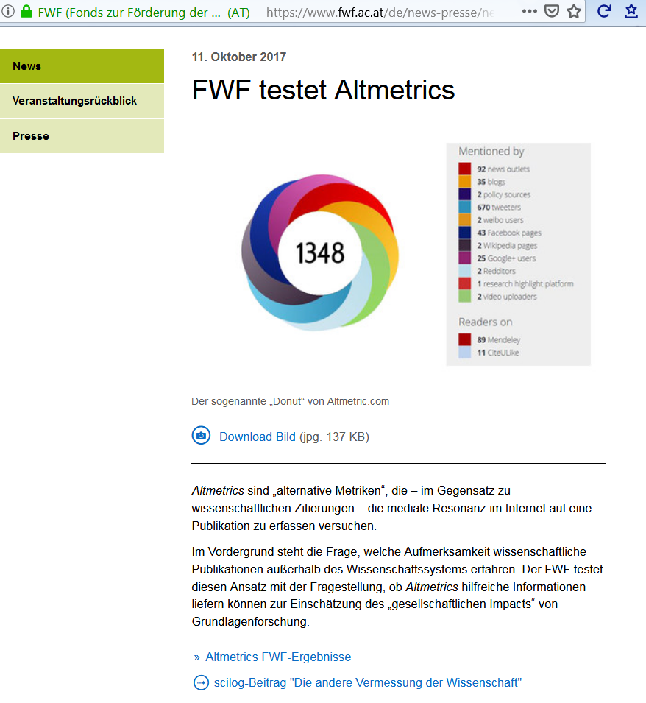
FWF is testing Altmetrics
Response to research contributions in (parts of) society
May prove “Societal Impact”
Altmetrics have weaknesses, but also show potential
Notes:
Examples for application of the mentioned questions
We have been in contact with FWF throughout the project period, but unfortunately it didn’t work out to have them present their project at one of our events. The perspective of funders is actually really interesting, because it could drive adaption of *metrics. Leading question is whether and how the assessment of the importance of research can meaningfully be supplemented by alternative parameters.
FWF evaluated publications from 2011 – 2017. Their current conclusion is:
that is it possible to see responses in parts of society
That it _may_ prove societal impact (without knowing how this is really defined)
Altmetrics have a great amount of weaknesses, but definitely have potential

Slide 5
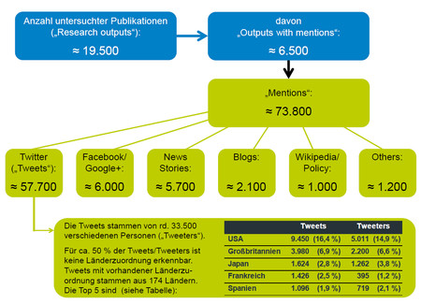
FWF Altmetrics result

Slide 6
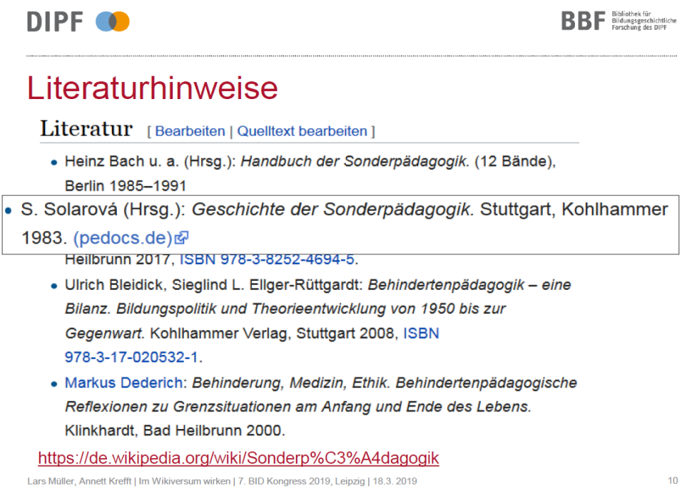
DIPF – Wikiversum project
How to measure Wikipedia impact?
Wikipedia usage can be detected
Comparable between repositories and over time
Serve as additional future performance indicator?
Notes:
One project that we were collaborating with is the Wikiversum project of DIPF (Leibniz Institute for Research and Information in Education). Their interest was focussed on 1 source: Wikipedia and how to measure „Wikipedia Impact“. They cannot use identifiers (like DOIs) and thus may not use aggregator services, but by specifically designing the API search they were able to detect their Wikipedia mentions.
Interim conclusion:
Usage can be compared between repositories and over time.
The use and linking of digital resources in Wikipedia reflects their transfer performance.
Open: will this in the future be accepted as an additional performance indicator

Slide 7
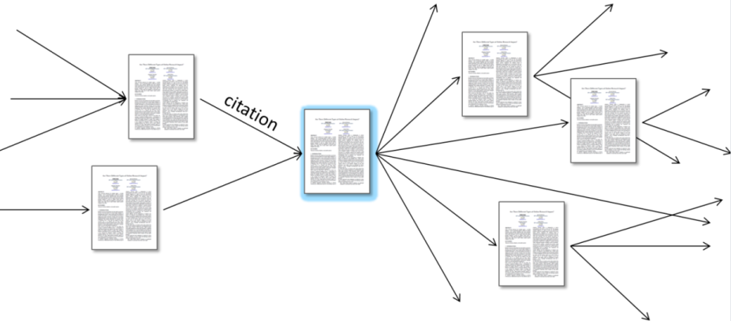
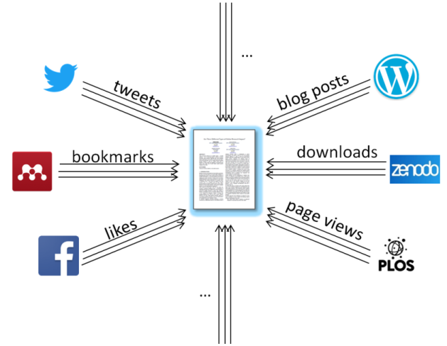
Traditional and Web-based metrics
Bibliometrics:
How often are scientific articles cited by other scientific articles?
Altmetrics/usage metrics (= web-based metrics):
How often do users interact with a scientific output online?
Notes:
Bibliometrics: citations and derived metrics: Journal Impact Factor, H-Index;
„simple“ because everyone is on the same playground and it is „just“ about referencing another article in a new publication
Altmetrics is much more complex: variety of platforms and different types of references; derived metrics are for instance Altmetric Badge, PLoS ALM
Advantages are: broader user groups, more publication formats (not only articles), higher speed, greater openness
Will it be an alternative or promising complement to traditional metrics

Slide 8
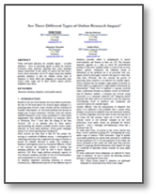
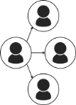



















Challenges for web-based metrics: heterogeneity
Platform types
Platforms
Action types
Attention towards a scientific output
on the Web
User groups
User groups
User groups
Great heterogeneity regarding
Usage purposes
User intentions
User demographics
Techn. complexity
[…]
Icons designed by Freepik from Flaticon.
Notes:
What are typical challenges of web-based metrics?
- Different platform types follow different modes of communication, attract userships that are the originators of the measured signals, and serve different purposes (also scientific – non-scientific)
- Platforms are specific instances of these platform types with concrete concrete characteristics (not least their accessibility)
- Great variety of functions allow different interactions (not all used according to their planned use, for instance in a number of platforms where no „bookmark“ function is available users will resort to „like“ or similar)
[these lists are not exhaustive]
So, this heterogeneity leads to a lot of questions that should be adressed – many of which we aim to address during our project. Differences in demographics and between disciplines are valuable for understanding the data that forms the basis for web-based metrics. Social sciences are already less represented in traditional citations (compared to e.g. natural sciences) and could profit from potentials of web-based metrics.

Slide 9





























Which online actions are executed most frequently by researchers of which career stages?
58 actions used by 150+ survey respondents:
Welch test comparisons of mean usage frequencies of early-stage researchers and professors
Writing
Commenting
Downloading
Liking
Sharing
Bookmarking
Other
Actions used more frequently by early-stage researchers:
Actions used more frequently by professors:

Slide 10
Main activities
User studies: surveys and interviews
User studies based on social media data
Technical evaluation and prototyping
Social Media Registry

Slide 11
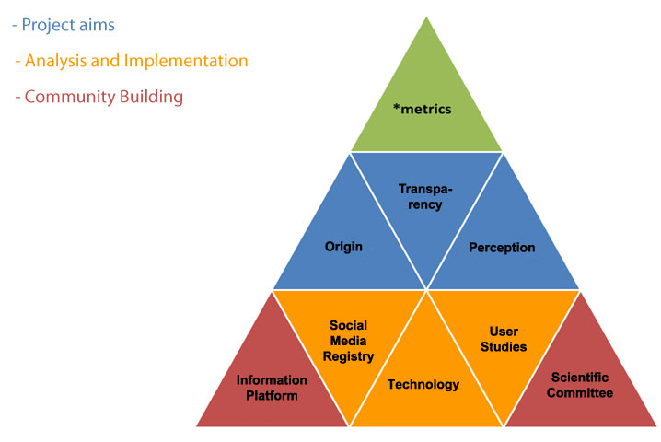
*metrics Project Structure
http://metrics-project.net

Slide 12
Integration in repositories
ZBW: EconStor
SUB: GoeScholar/GRO
GESIS: SSOAR
VZG: Embedding in repository software

Slide 13
Thank you / Vielen Dank!
Web https://metrics-project.net/
Email metrics-project@sub.uni-goettingen.de
Twitter @metrics_project
Facebook @metricsproject

